Slide 2
The Sound Of Silence
"the inability of people to communicate with each other, not particularly intentionally but especially emotionally, so what you see around you are people unable to love each other."

Slide 3


Slide 4
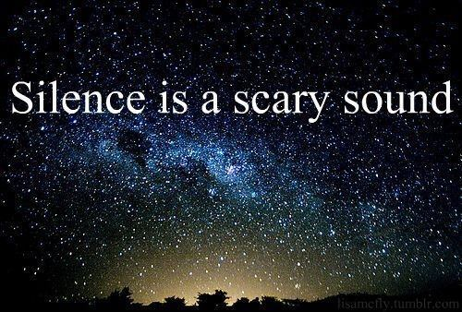

Slide 5
The Sound of Silence…..
“Silence” “absence of any sound”
Times when the sound of silence needs to be heard!
Also important in instructions given to children.
“Buy a loaf of bread and ½ gallon of milk.”
SILENCE regarding what NOT to purchase
Buy candy, gum, etc. in addition to Milk & Bread
Punishment would be forthcoming!

Slide 6
GOD’S SILENCE IS AUTHORITATIVE IN ALL THINGS
Ark – Noah understood and respected this principle- Genesis 6:14-16
Noah knew whenever God SPECIFIED, He did not have to list all of the unacceptable alternatives
In giving SPECFIC INSTRUCTIONS to Noah, God was using a figure of speech called ELLIPSIS
When God specified GOPHER WOOD, He was not under obligation to list any others!
“Gopher wood ONLY!” {“only” being the ELLIPSIS}

Slide 7
GOD’S SILENCE IS AUTHORITATIVE IN ALL THINGS
Appointment of Priests – Hebrews 7:13,14
The SILENCE OF GOD concerning ANY OTHER TRIBE was AUTHORITATIVE!
Fire to be us in Burning Incense – Leviticus 10:1-7
Nadab and Abihu thought FIRE was FIRE!
Although God specified a certain fire, they substituted ANOTHER!
Fire from God consumed them both!
Wrath poured out directly on those who fail to hear the SILENCE OF HIS WORD!

Slide 8
GOD’S SILENCE IS AUTHORITATIVE IN ALL THINGS
Transporting The Ark of the Covenant – 2 Samuel Chapter 6
God commanded it be carried on the shoulders of the Priests – Numbers 4:15
God’s displeasure seen when Uzzah reached out to steady the ark – INSTANTLY STRUCK DEAD!
David realized his sin and sent priests to carry it back
Important In Inspiring the Apostles and Prophets to Speak and write- 1 Corinthians 4:6; Acts 5:24

Slide 9
PRESENT DAY APPLICATIONS
Elements of the Lord’s Supper – Luke 22:14-20
He did NOT SAY: “You shall not serve Hamburgers with it, nor Fried chicken!”
His Silence on any other element limits the elements to UNLEAVEN BREAD and FRIUT OF THE VINE!
To ADD or to TAKE AWAY from this is the DISOBEY THE COMMANDMENT OF THE LORD!

Slide 10
PRESENT DAY APPLICATIONS
Music We Use In Worshiping Him – “SING”
Ephesians 5:19; Colossians 3:16
Not only when together – Acts 16:25
When God has SPECIFIED (Colossians 3:16) and by way of example (Acts 16:25) What Does The Silence of God tell us?
To use mechanical instruments in the singing of praises to God at any time is as sinful as carrying the Ark on a new oxcart!

Slide 11
“Where the Bible Speaks, We Speak; Where the Bible is Silent, We Are Silent.”
“Where the Bible Speaks, We Must Be Silent; Where the Bible is Silent, We May Speak.”

Slide 12
“Those who accept the theory of the permissiveness of silence are ever seeking to lay down laws of restraint to control their membership.”

Slide 13
Whenever we refuse to hear the Silence of the Scriptures in ONE area, what is to keep us from turning a deaf ear in another area?

Slide 14
Do You Respect The Authority of God’s Word Today?

Slide 15
Both what is SAYS and where it is SILENT?

